Slide 1
Screencastify
Tanya Rosenkranz
Indian Creek Elementary – Linn Mar School District
trosenkranz@linnmar.k12.ia.us

Slide 2
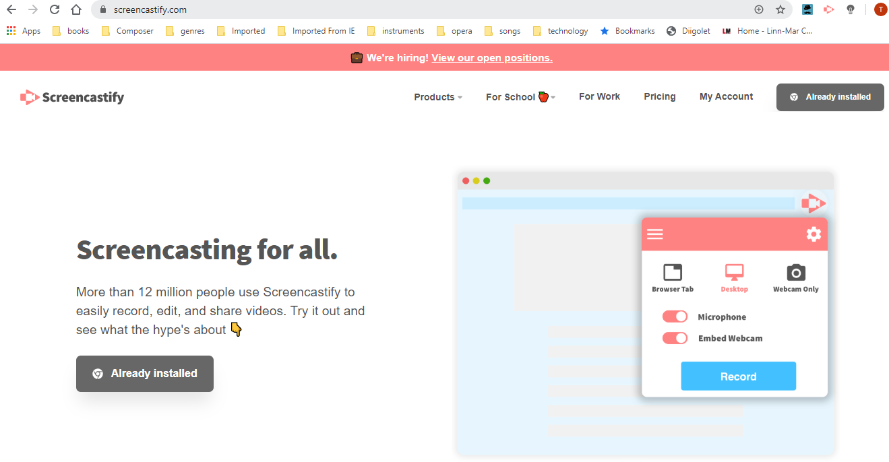

Slide 3
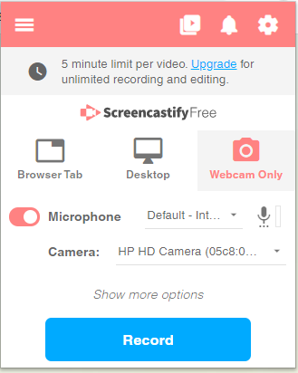
Webcam – you, in all your glory!
Desktop – shows whatever is on your desktop,
can also chose to have your picture in the
corner, or not.
Browser Tab – great if you want to show how to
navigate on a webpage

Slide 4
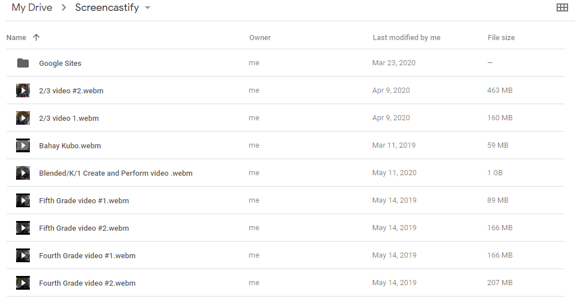
Video saves in Google Drive in the Screencastify folder.

Slide 5
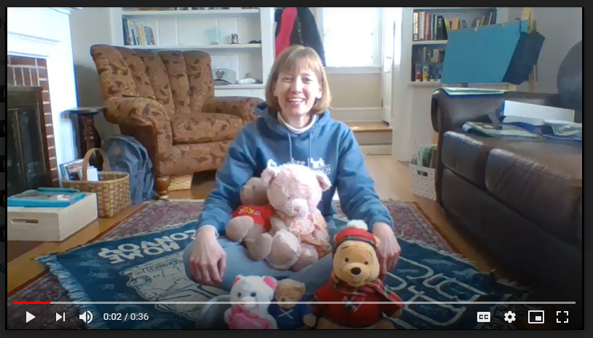

Slide 7
Uses/Benefits of Screencastify:
Record lessons for a substitute to play for the students. – My favorite use!
Great for asynchronous learning.
Good quality for a free program!
Cons:
1. Five minute limit on the free version.
2. No editing on the free version.
3. Limited editing on paid version.
If you want even more information:
screencastify.com -- For School -- Courses -- will walk you through everything Screencastify does in extreme detail!

Slide 8
For the Coming Year:
Focus on Social Emotional Learning:
From simplemusicteaching.com/2018/08/28/sel
Feeling wheel in the hallway
Feelings chart inside the door
Students will point to how they are feeling so I can acknowledge
Screencastify 3-4 activity/song/centering on the screen while I
welcome students to music.

